Slide 1
Innovative Projects- Arduino Using Embedded ‘C’ (CSE1002)
Phase –2 Review Presentation
Designing Of "PIT VOLUME TOTALIZER" Using Arduino
Submitted to the Presidency University, Bengaluru in partial fulfillment of the requirements for the Innovative Project- Arduino Using Embedded ‘C’
By
IPC-10
Under the supervision of
Mr. Bhairab Jyoti Gogoi
Assistant Professor
Department of Petroleum Engineering
March , 2022
Name | Roll Number
Shashank S N | 20211CSE0214
Sahana G M A Bhuvana | 20211CSE0213 20211MEC0012
Mohammed Aiman Khan Vaibhav V | 20211EEE0026 20211CAI0108
Ruthvik M K | 20211ECE0236

Slide 2
Project Brief Summary
Overview:
By using a flow sensor with a microcontroller like Arduino, we can calculate the flow rate, and check the volume of liquid that has passed through a pipe, and control it as required.
Objectives:
In this project, we are going to build a water flow sensor using Arduino. We will interface the water flow sensor with Arduino and Laptop, and program it to display the volume and flowrate of the water, which is passing through the valve. For this particular project, we are going to use the YF-S201water flow sensor, which uses a hall effect to sense the flow rate of the liquid.
Outcome:
Apart from manufacturing industries, this device can also be used in the: Agriculture sector, Food processing, Water management, Mining industry, Petroleum Industry, Water recycling, Coffee machines, etc.
Further, a water flow sensor will be a good addition to projects like Automatic Water Dispenser and Smart Irrigation Systems where we need to monitor and control the flow of liquids.

Slide 3
Challenges Faced in Project
The main challenge that occurred during the building of device was the code implementation for the water flow calculation.
How to overcome it :-
As you might know,
1 Liter = 1000 mL
So, the range of the YF-S201 sensor will be 300mL to 6000mL per minute.
At 1000mL you get 5880 pulses, but if it is over a minute otherwise over a second it will be 5880/60 = 98 Hz square wave which has a period of 1/98 = 10.2 milliseconds.
For 1mL we calculated 5880/1000 = 5.88/60 = 0.098Hz with a period of 10.2 seconds. In the programming, we will be using the "pulsein" function to measure the time of a pulse.

Slide 4
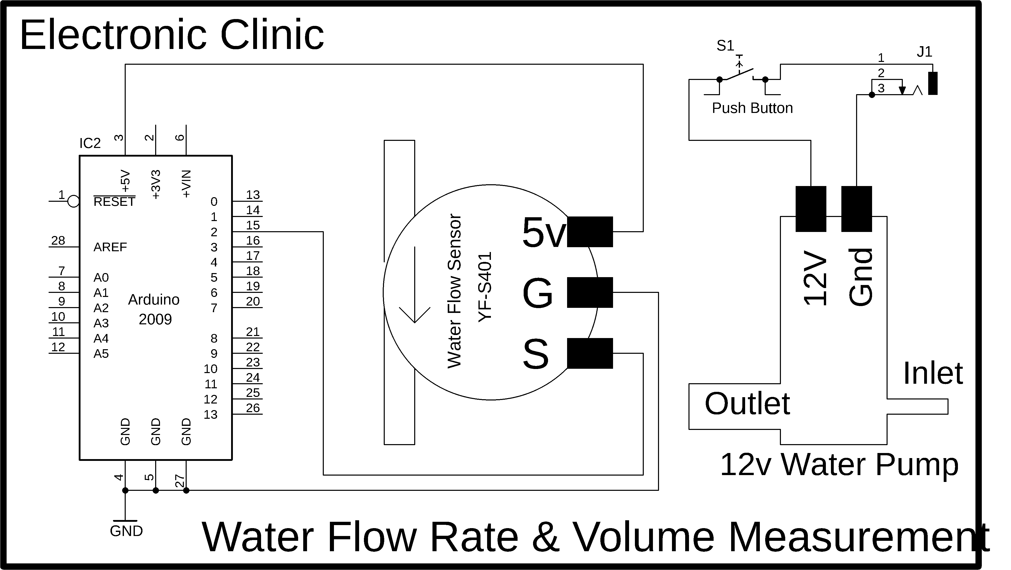
Circuit/Block Diagram

Slide 5
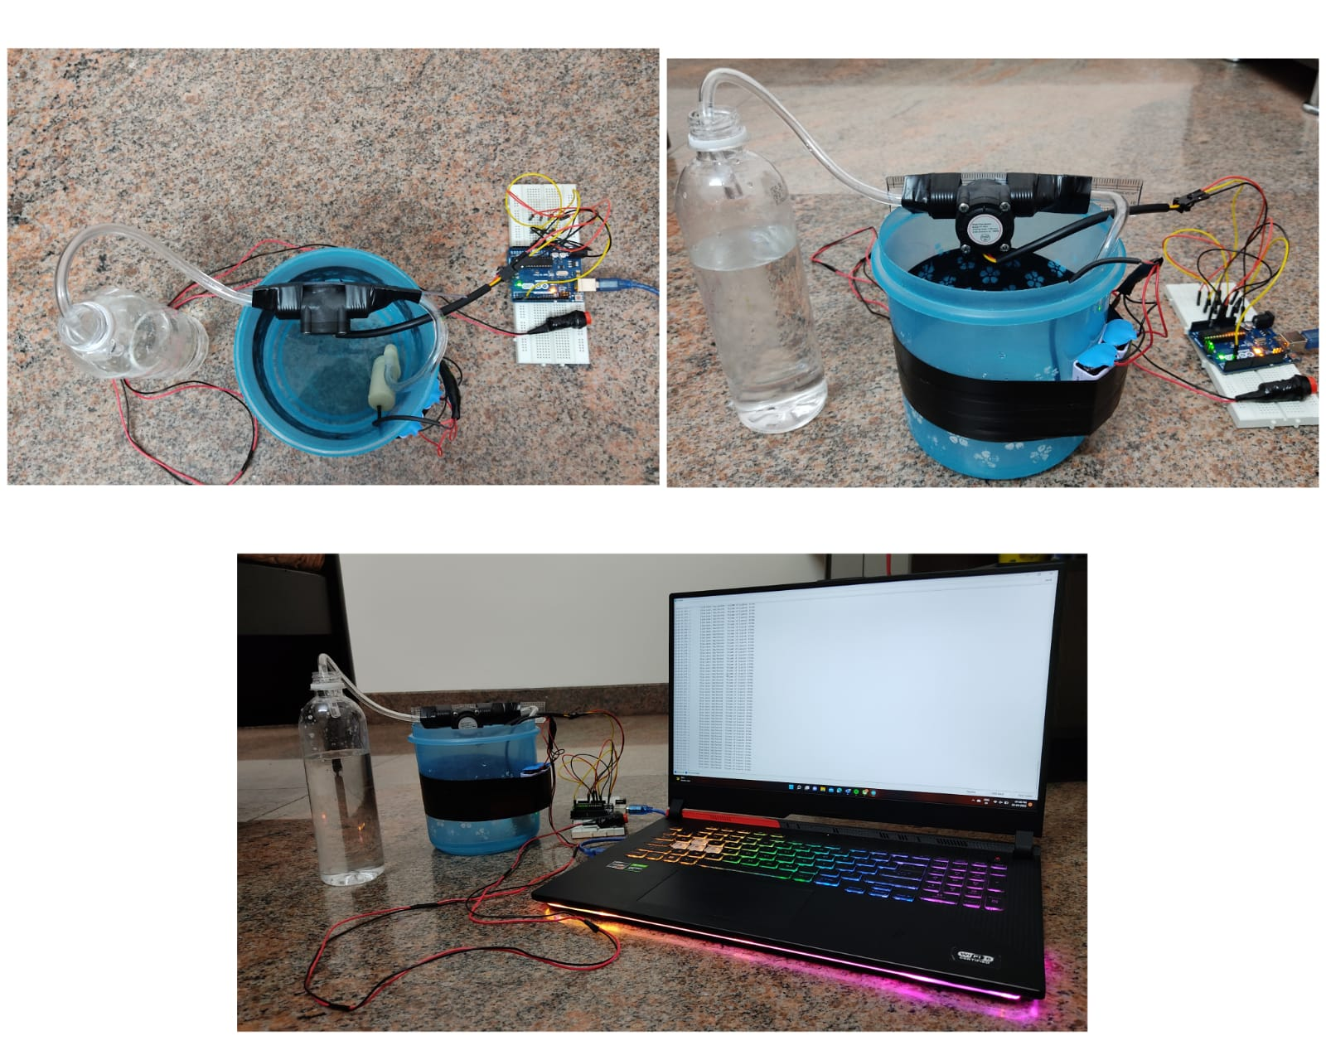
Obtained Results

Slide 6
Project Timeline
Phase 1
Initiation:
Phase 2
Planning:
Phase 3
Execution:
"Starting of the project", which includes holding kickoff meeting with the group and developing the resources needed to develop the project plan.
"Organization and preparing", which includes the planning of blueprint of the project and estimation of the financial cost of the project.
Week - 1
Week - 2 & 3
"Carrying out the work", which includes building of the project, writing and implementing the code as part of programming, and finally running the testrun to check the accuracy of the device.
Week – 4 & 5

Slide 7
Q&A

Slide 8
Thank you !!

